Slide 1



GitHub Copilot
Use Cases
Development Discipline
September 2023

Slide 2


How Copilot Works
Copilot is powered by OpenAI Codex, a new AI system created by OpenAI. OpenAI Codex is a descendant of GPT-3, the powerful language model that OpenAI released last year.
OpenAI Codex is trained on a selection of English language and source code from publicly available sources, including code in public repositories on GitHub.
OpenAI Codex is exclusively licensed to GitHub.

Slide 3

Overview
Tool that helps you write code.
Suggests whole lines or entire functions right inside your editor.
As you type, it adapts to the way you write code, to help you complete your task, suggesting likely next lines and providing accurate type information
https://copilot.github.com/#faq

Slide 4

Capabilities
Works with a broad set of languages and frameworks, including:
Python
JavaScript
TypeScript
Ruby
Go
And is designed to integrate seamlessly into your workflow.

Slide 5
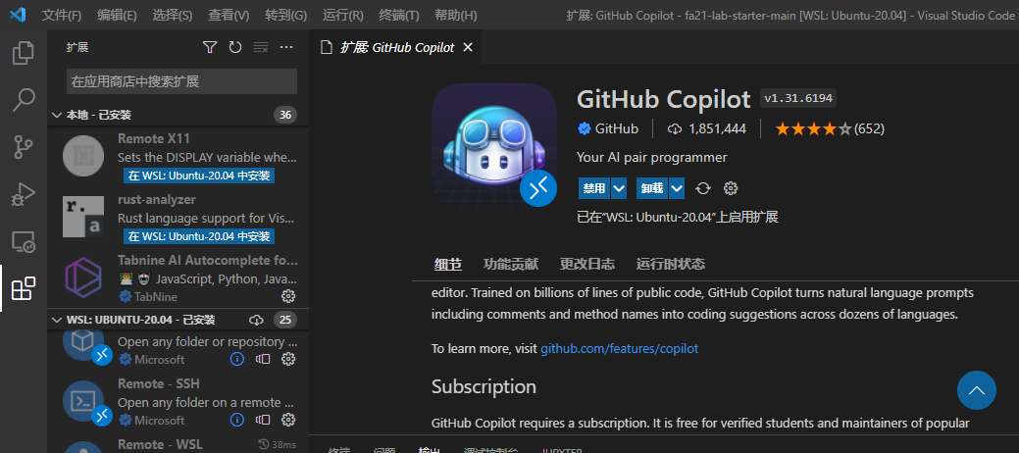
Integrations
Copilot is available as a Visual Studio Code extension.
Sign into your GitHub account from within VS Code or from the command line.
Then start using Copilot in any repository on GitHub.com, GitHub Enterprise Server 3.0, or any local repository.

Slide 6
Considerations
Inaccurate or incomplete answers
Can’t always provide an accurate or complete code. There may be cases where its response is not relevant or based on incorrect or incomplete information.
Data bias
Is trained on a large amount of code and may reflect any bias present in the data. Therefore, some codes may be influenced by data biases, which could lead to incorrect code.
Lack of fullContext
Can’t always fully comprehend the whole code context or problem. A response may seem appropriate, but without a deep understanding of the context of the problem, it may not be the best solution.

Slide 7
Risks
The code created with Copilot can be shared depending on the account subscription.
The code suggested can be licensed by third-parties.
Enabling or disabling duplication detection:
GitHub Copilot includes a filter which detects code suggestions matching public code on GitHub: https://docs.github.com/en/copilot/configuring-github-copilot/ configuring-github-copilot-settings-on-githubcom#enabling-or-disabling-duplication-detection

Slide 8
Final recommendations
Copilot works better if we:
Divide code into small functions.
Use meaningful names for functions, variables, and parameters.
Write good docstrings and comments as you go.
Write the code in a sequential/structured way from the beginning.
Use cases when Copilot help (a lot):
Generating user-defined functions.
Generating documentation.
Generating test cases.
Generating standard functions (sort, find, connect, …)
Improving/refactoring code.
Suggesting contextualized text (no code).
Translating/using other programming languages.
Navigating unfamiliar libraries or frameworks.
Avoiding some mistakes like forgetting steps or conditions
Exploring new/different code options.

Slide 9

Thank you! Give us your Feedback!
Development Discipline

Slide 10
Appendix 1 – Quick start
Acquire an active GitHub Copilot subscription:
Get it from: https://github.com/features/copilot/
Detailed explanation: https://docs.github.com/en/billing/managing-billing-for-github-copilot/about-billing-for-github-copilot
Install VS Code (if not already) from: https://code.visualstudio.com/Download
Install VS Code extension GitHub Copilot from: https://marketplace.visualstudio.com/items?itemName=GitHub.copilot
Login to GitHub, approve permissions, connect to GitHub copilot and reload editor.
Seeing suggestions:
To accept the suggestion, press Tab. To reject all suggestions, press Esc.
Hover over the suggestion to see the GitHub Copilot command palette for choosing suggestions.
Full step-by-step description:
https://docs.github.com/en/copilot/getting-started-with-github-copilot?tool=vscode
Development Discipline

Slide 11
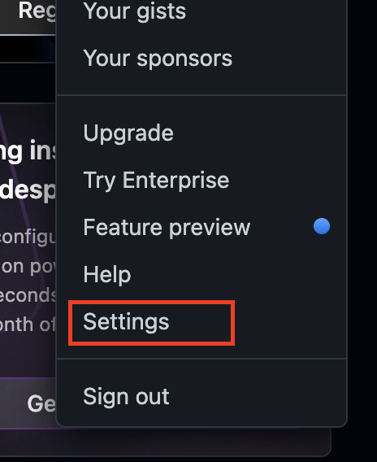
Appendix 2 – Step by step
Go to: https://docs.github.com/en/copilot
Acquire GitHub Copilot
First you need to subscribe to the service to start coding, for that you need to enter to your GitHub account and go to Settings.
Development Discipline

Slide 12
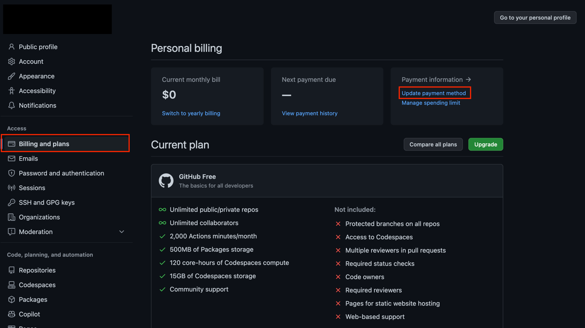
Appendix 2 – Step by step
Then click on the ‘Billing and plans’ on the left panel once you are there on the ‘Payment information’ box click on ‘Update payment method’. If you have an student GitHub plan, copilot is free
Development Discipline

Slide 13
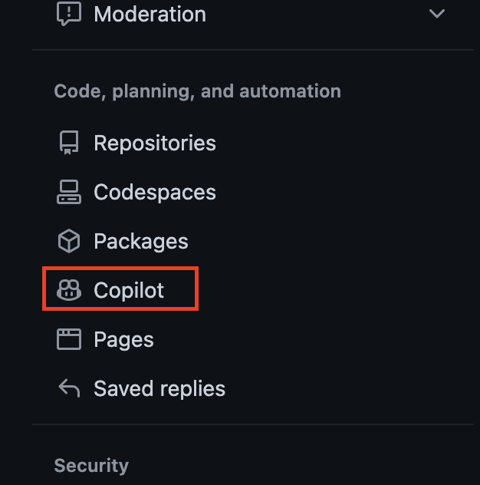
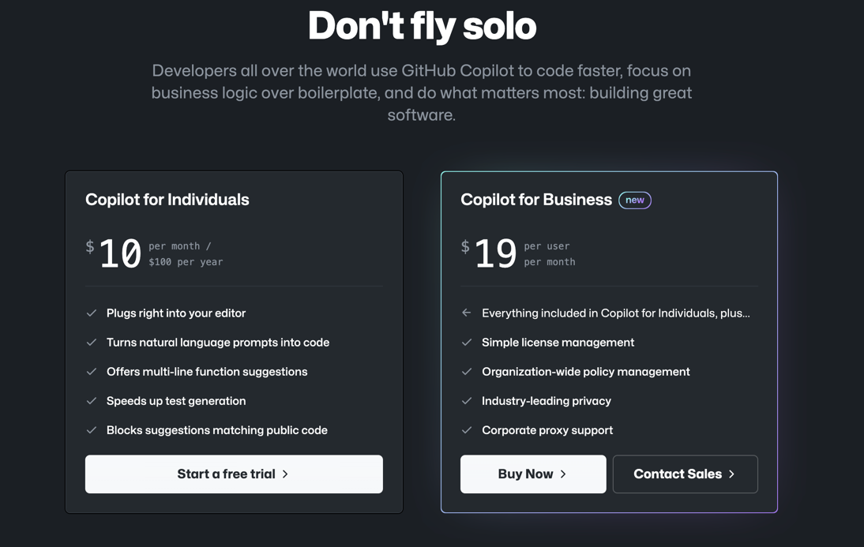
Appendix 2 – Step by step
Click on the left panel the ‘Copilot’ and Select the copilot subscription.
Development Discipline

Slide 14
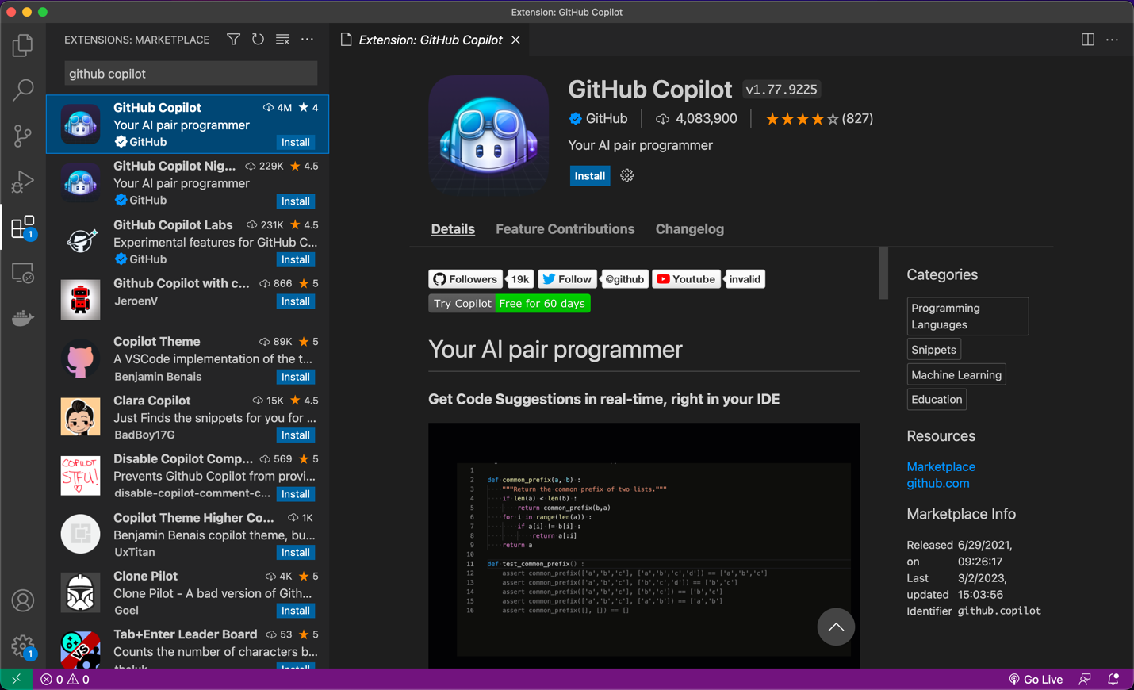
Appendix 2 – Step by step
Connect Copilot with VS Code. Open Visual Studio Code and go to the extension option on the left side of the editor. Search for the GitHub Copilot extension and install it.
Development Discipline

Slide 15

Appendix 2 – Step by step
Connect to your GitHub account previously configured.
Development Discipline

Slide 16
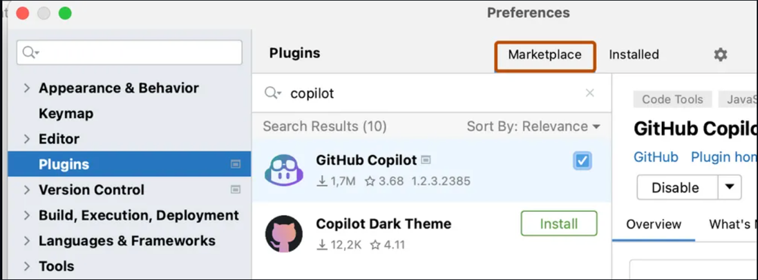
Appendix 2 – Step by step
In IntelliJ go to ‘Preferences’/’Setting’, look for the ‘Plugins’ option on the left bar and click on it. Look for the ‘GitHub Copilot’ extension and install it.
Development Discipline

Slide 17
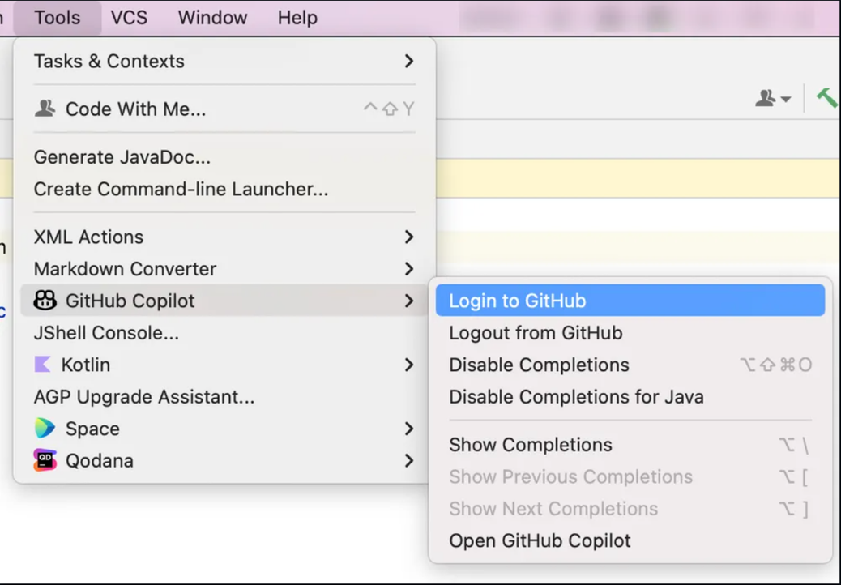
Appendix 2 – Step by step
Restart it once installed, then go to the tools menu and check for the new ‘GitHub copilot’ option that now appears and then Log in to your GitHub account.
Development Discipline

Slide 18
Appendix 3 – Use cases examples
The following collection of images were taken from real (personal) codes.
The grey characters are the Copilot suggestions for each case.
Development Discipline

Slide 19
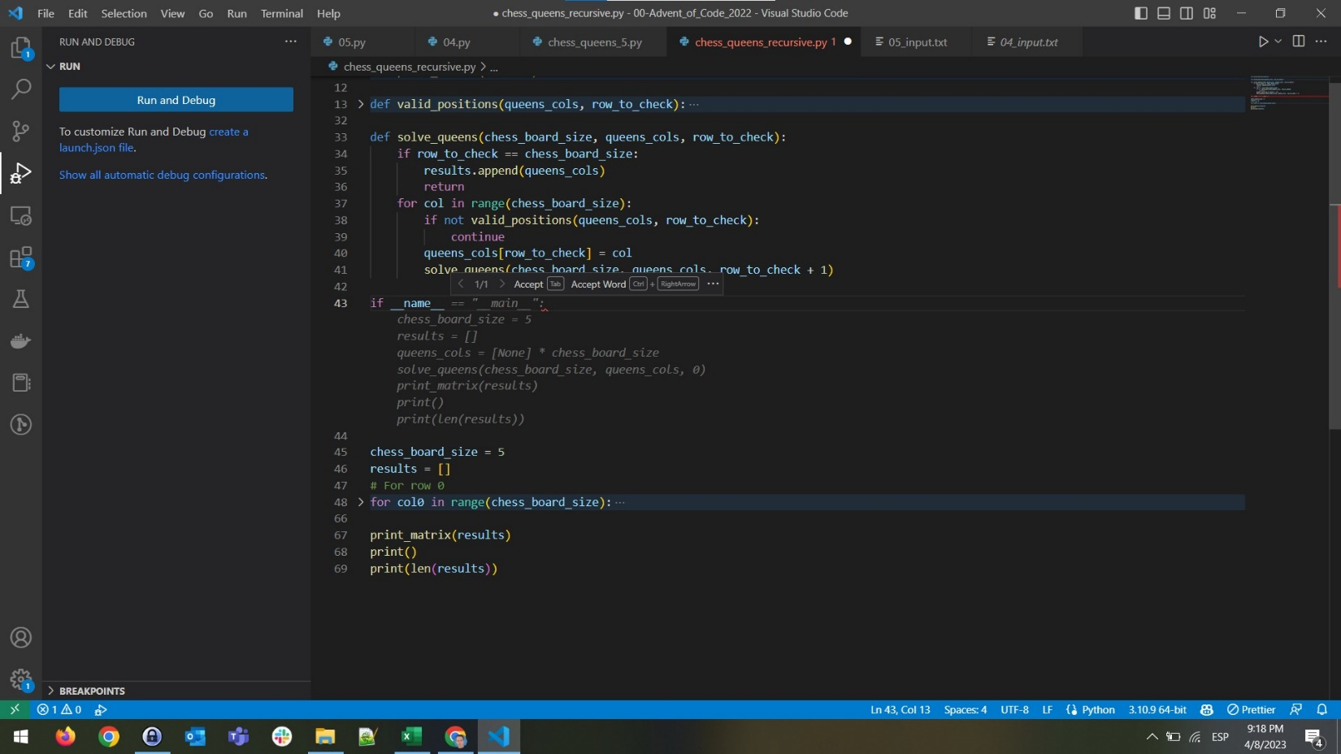
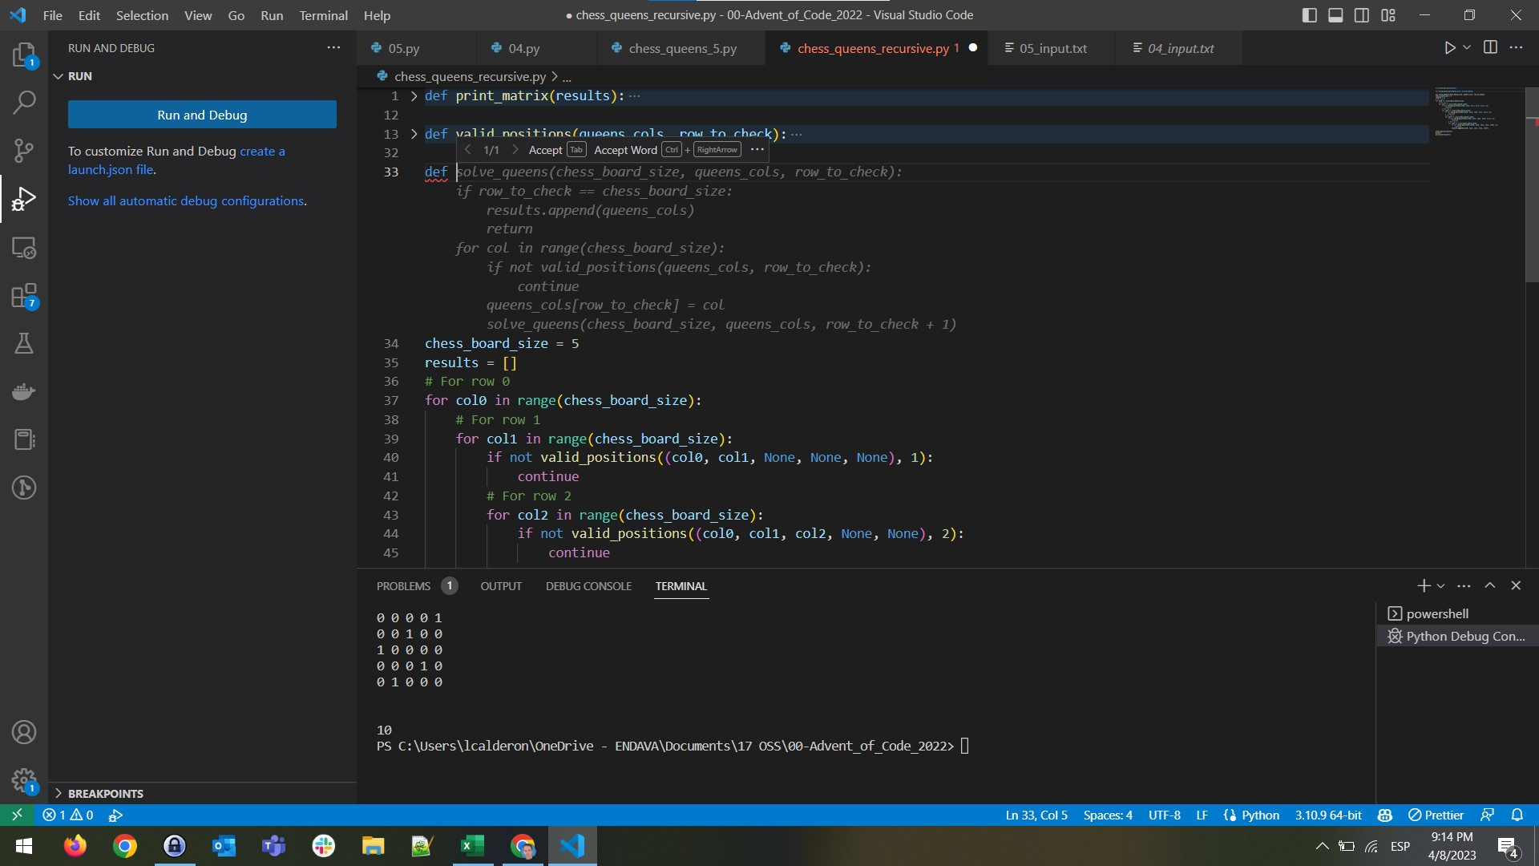
Appendix 3 – Use cases examples
Entire functions created with Copilot after some code was in place.
Development Discipline

Slide 20
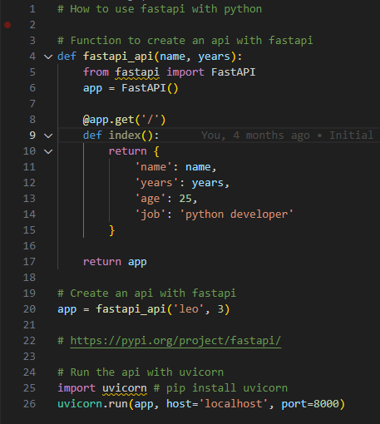
Appendix 3 – Use cases examples
All this code was created with Copilot just with the initial comments, to explore the unknow FastAPI Framework.
Development Discipline

Slide 21
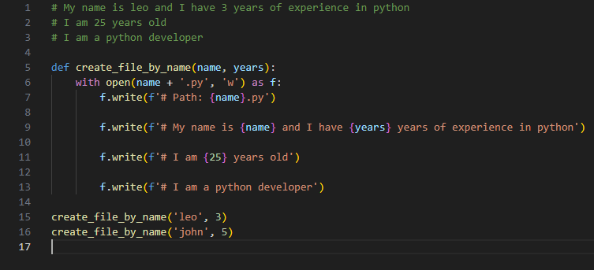
Appendix 3 – Use cases examples
Function entirely created with Copilot just with the three comments and the function name.
Development Discipline

Slide 22
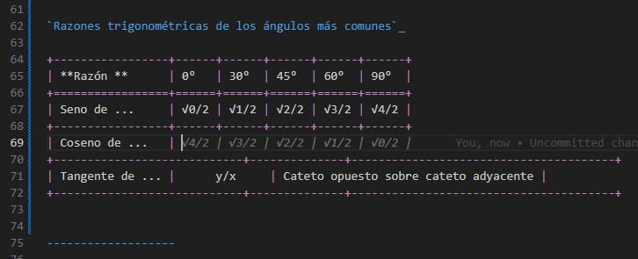
Appendix 3 – Use cases examples
Some suggestions with Trigonometry, all these are right answers.
Development Discipline

Slide 23
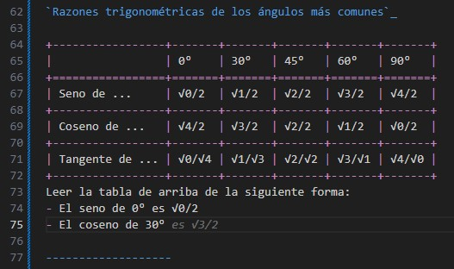
Appendix 3 – Use cases examples
Some suggestions with Trigonometry, all these are right answers.
Development Discipline

Slide 24
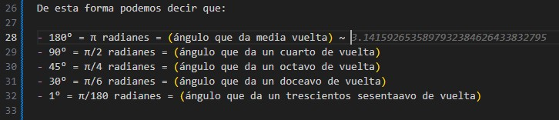
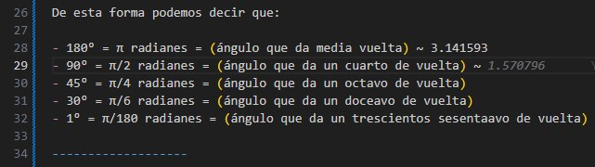
Appendix 3 – Use cases examples
Some suggestions with Trigonometry, all these are right answers.
Development Discipline

Slide 25
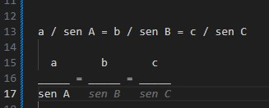
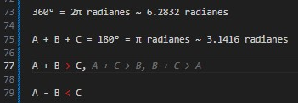
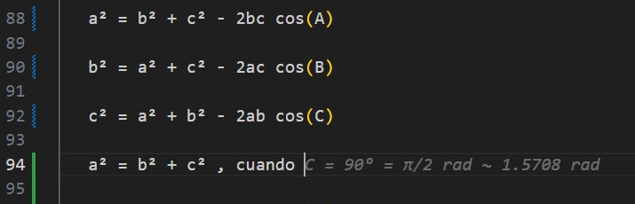
Appendix 3 – Use cases examples
Some suggestions with Trigonometry, all these are right answers.
Development Discipline

Slide 26
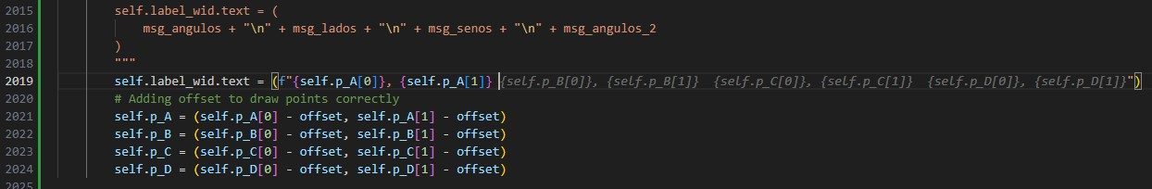
Appendix 3 – Use cases examples
More suggestions based on code around:
Development Discipline

Slide 27
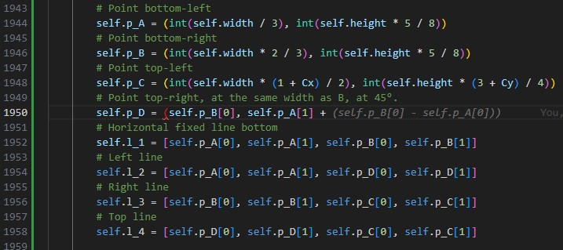
Appendix 3 – Use cases examples
More suggestions based on code around:
Development Discipline

Slide 28
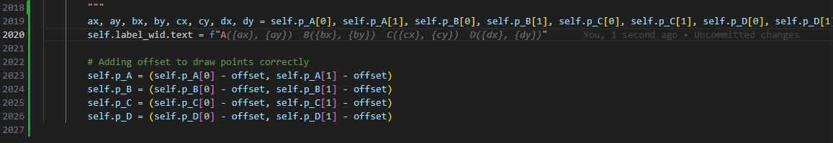
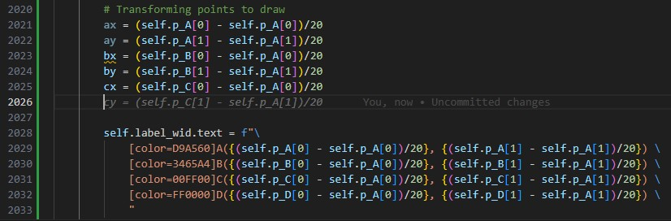
Appendix 3 – Use cases examples
More suggestions based on code around:
Development Discipline

Slide 29
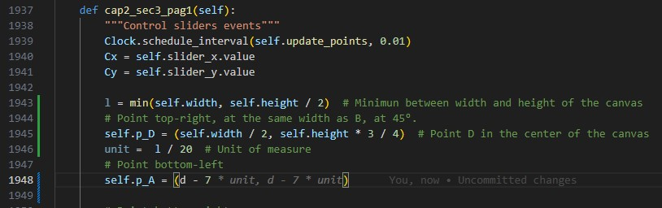
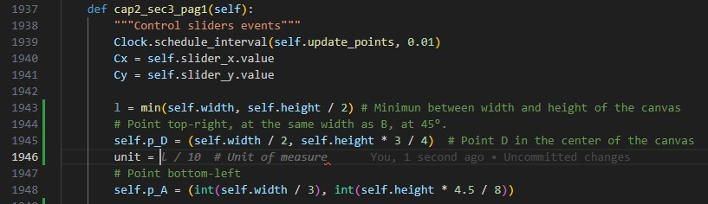
Appendix 3 – Use cases examples
More suggestions based on code around:
Development Discipline

Slide 30
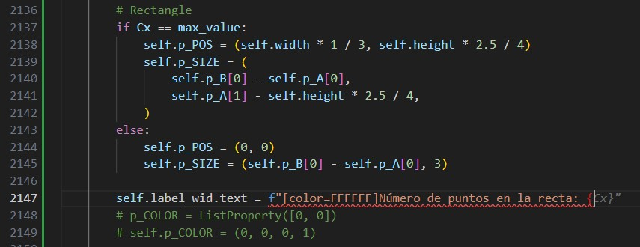
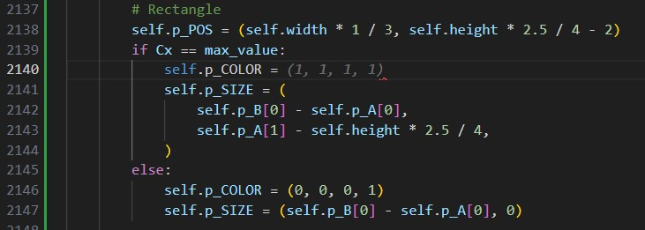
Appendix 3 – Use cases examples
More suggestions based on code around:
Development Discipline

Slide 31
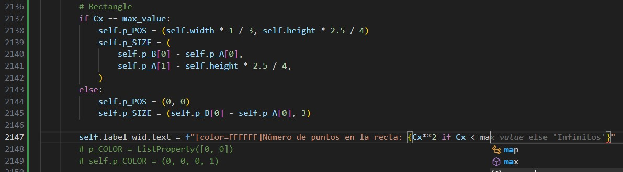
Appendix 3 – Use cases examples
More suggestions based on code around:
Development Discipline

Slide 32
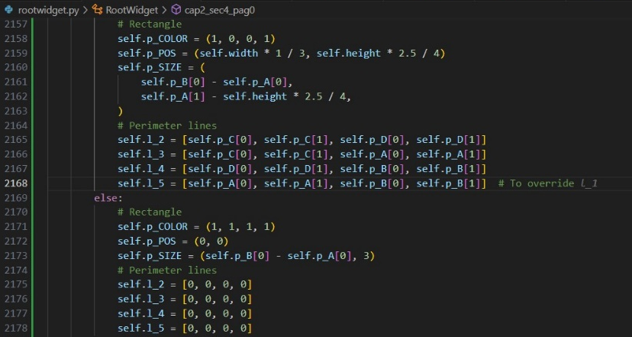
Appendix 3 – Use cases examples
This was true! The variable self.l_5 was for override the horizontal mobile line l_1
Development Discipline

Slide 33
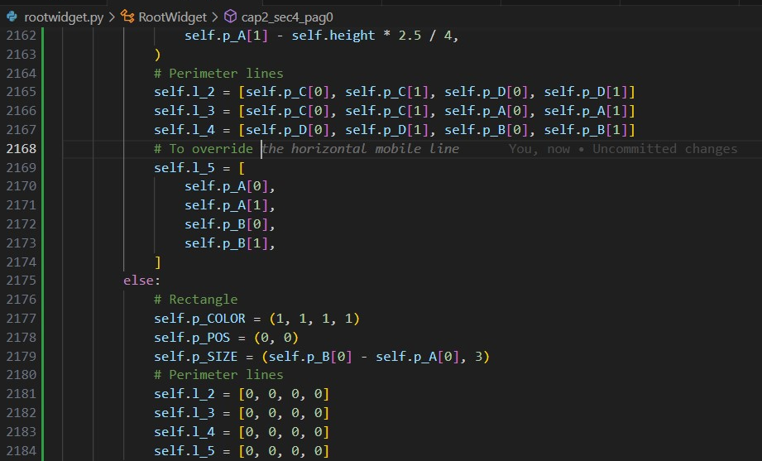
Appendix 3 – Use cases examples
This was true! The variable self.l_5 was for override the horizontal mobile line l_1
Development Discipline

Slide 34
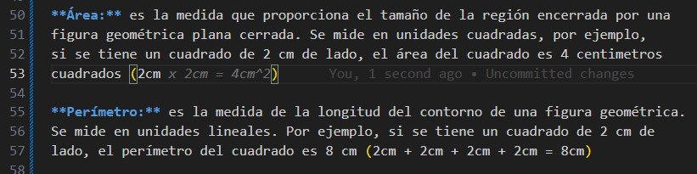
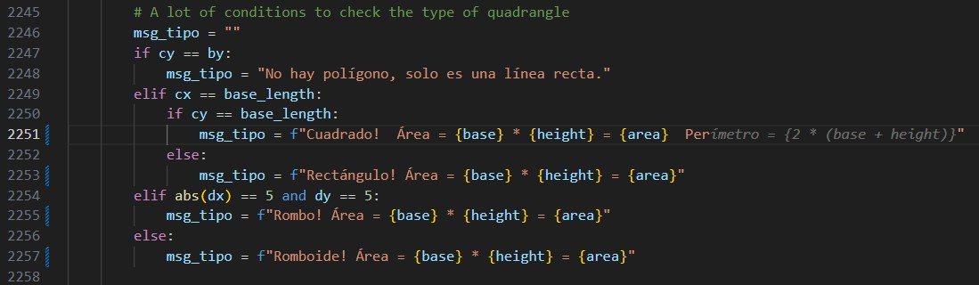
Appendix 3 – Use cases examples
More complex suggestions based on code around:
Development Discipline

Slide 35
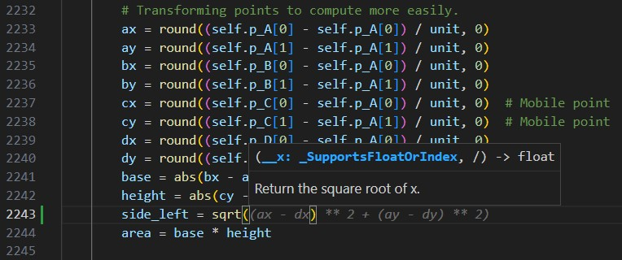
Appendix 3 – Use cases examples
More complex suggestions based on code around:
Development Discipline

Slide 36
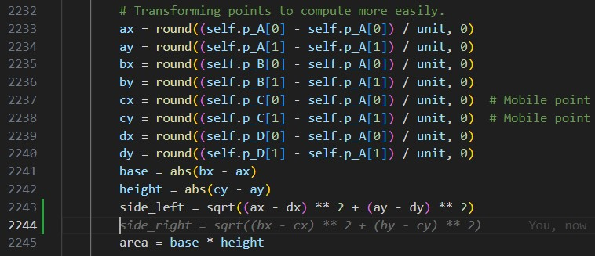
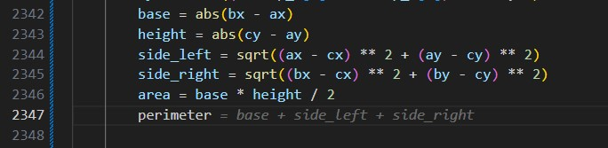
Appendix 3 – Use cases examples
More complex suggestions based on code around:
Development Discipline

Slide 37
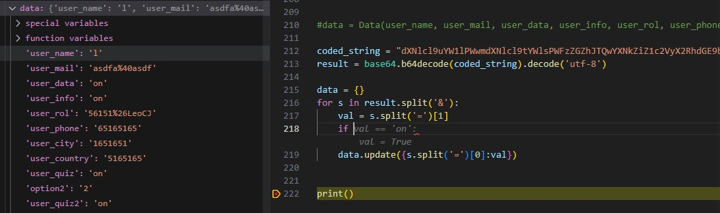
Appendix 3 – Use cases examples
Correct logic suggestions based on the previous code!
Development Discipline

Slide 38
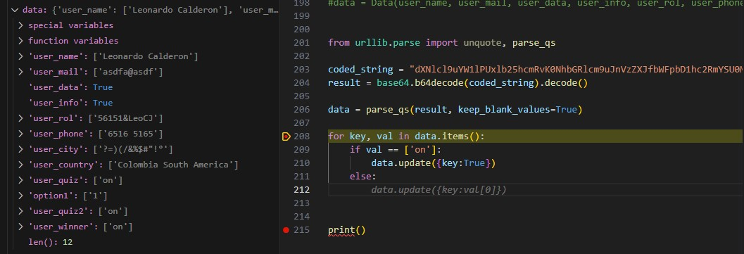
Appendix 3 – Use cases examples
Correct logic suggestions based on the previous code!
Development Discipline

Slide 39
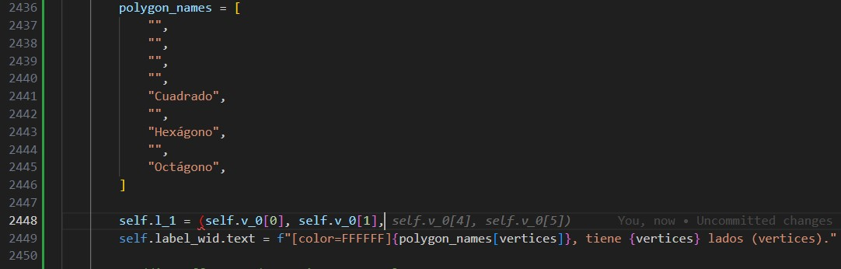
Appendix 3 – Use cases examples
All this code was generated automatically, and it was correct!
Development Discipline

Slide 40
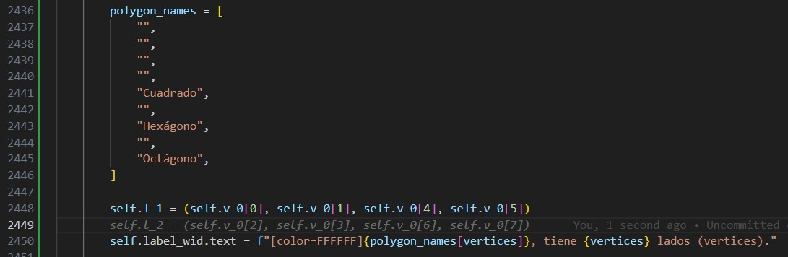
Appendix 3 – Use cases examples
All this code was generated automatically, and it was correct!
Development Discipline

Slide 41
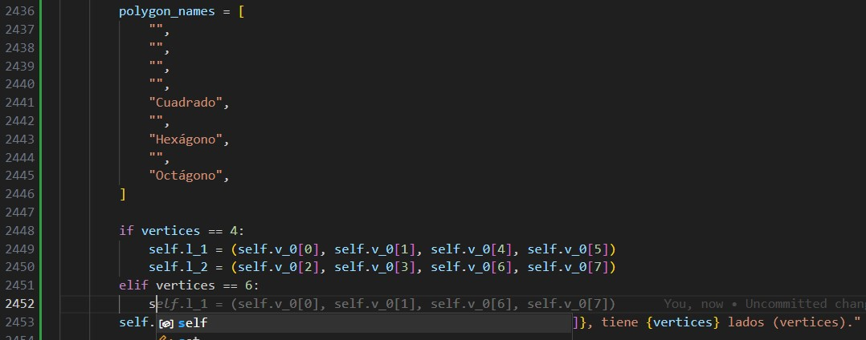
Appendix 3 – Use cases examples
All this code was generated automatically, and it was correct!
Development Discipline

Slide 42
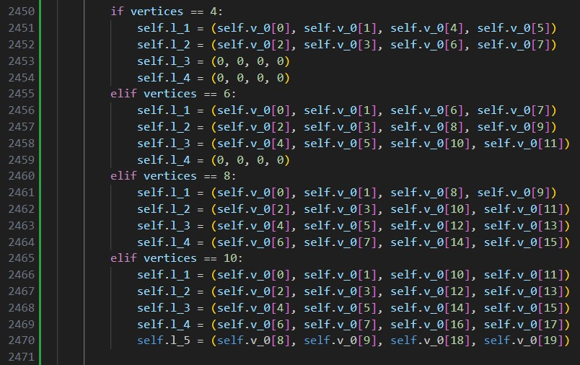
Appendix 3 – Use cases examples
All this code was generated automatically, and it was correct!
Development Discipline

